Slide 1



CIS2101 Database Systems
Dr. Menna Maged
& Dr. Logein Ahmed
Blue Wave
Martime System
Members:
Amal Youssef(231005601)
Shahd Mohamed(231005400)
Omar Mohamed(17105312)
Ahmed Alyasergy(231005915)

Slide 2
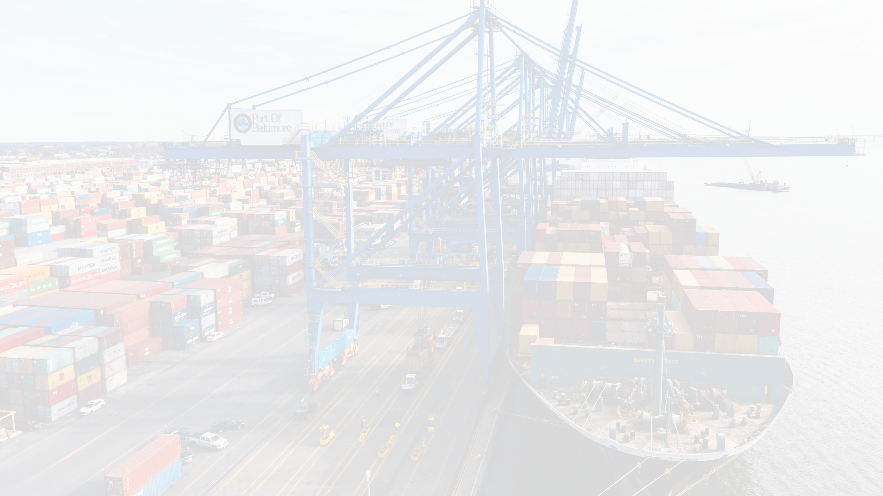


Introduction
The "BlueWave Maritime System" project aims to design and implement a comprehensive system for managing maritime operations such as ship scheduling, passenger booking, cargo tracking, and port management. The system provides solutions to improve operational efficiency, reduce human errors resulting from manual processes, enhance data accuracy and reporting, and improve the user experience. The project addresses current issues facing the maritime transport sector, such as manual errors, delays, and poor service quality.

Slide 3


In the current situation, maritime transport management operations rely primarily on manual methods, leading to an increased likelihood of human errors and delays in processes. The existing system lacks efficiency in tracking and scheduling operations. To address these issues, the "BlueWave Maritime System" project proposes an electronic system that offers integrated solutions to improve organization, reduce errors, and enhance the user experience.
problem
analysis

Slide 4

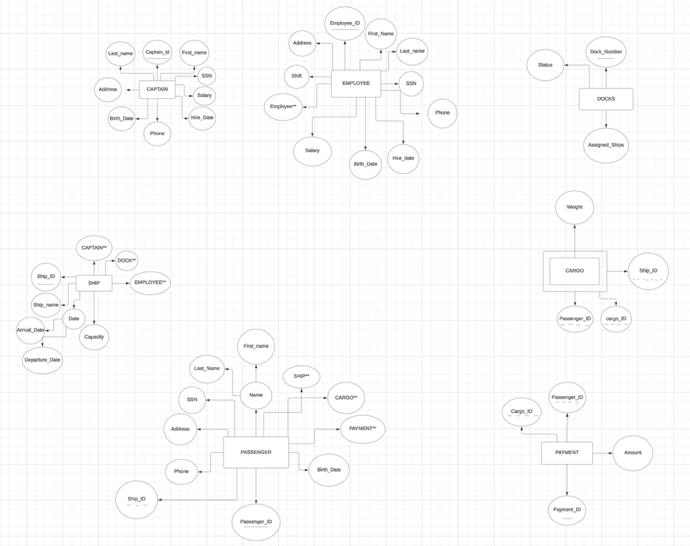
Rough ER-Diagram
Note:
There is a weak entity in the rough schema, which is CARGO, because it is dependent on the PASSENGER entity, based on whether the passenger has cargo or not.

Slide 5
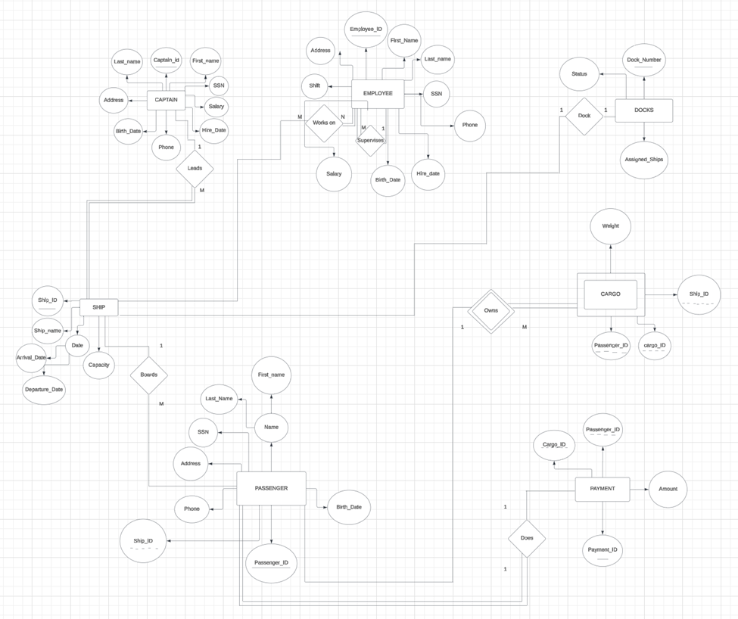
Final
ER-Diagram
Rough ER-Diagram
The relationship between Entity.
· (Captain & Ship) 1:m
· (Employee & Ship) m:n “one ship contains many of employees and one employee can work in more than ship”.
· (Employee & Employee) à1:m
· (Ship & Docks) 1:1
· (Ship & Passenger) 1:m
· (Passenger & Cargo) 1:m
· (Passenger & Payment) 1:1

Slide 6
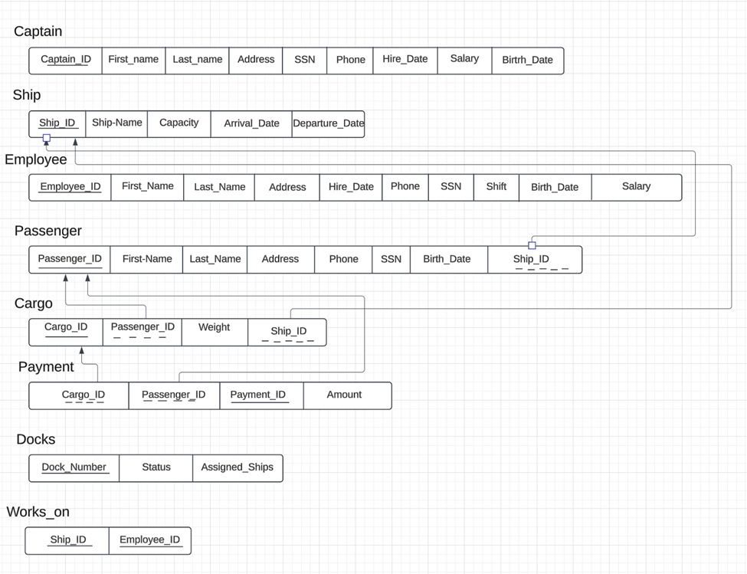
Final
ER-Diagram
Mapping ER-Diagram
(Works_on) is the relationship between (Employee) and (Ship) (m:n)

Slide 7
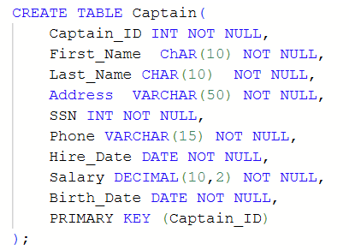
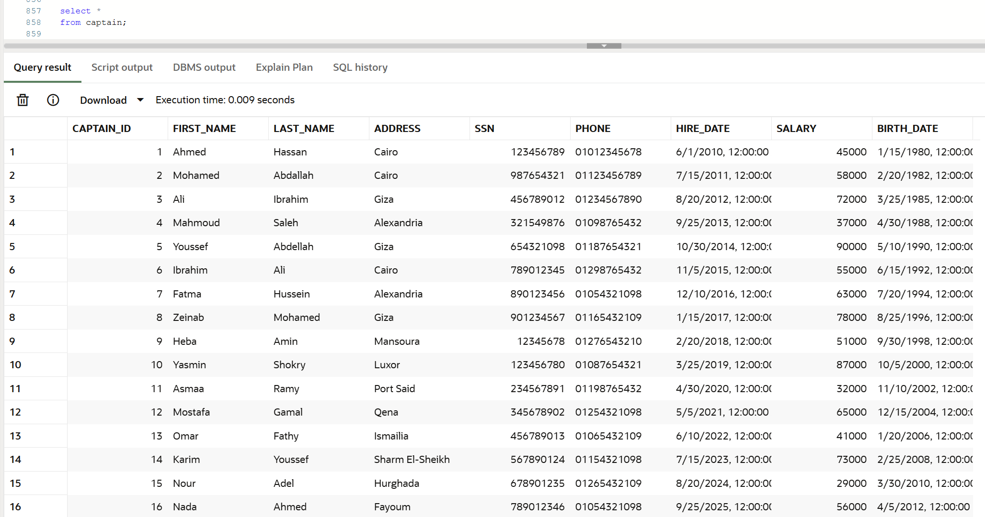
SQL
GBG
Create and select the Captain

Slide 8
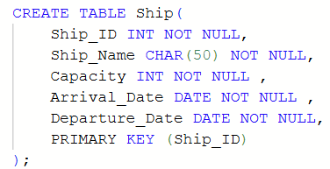
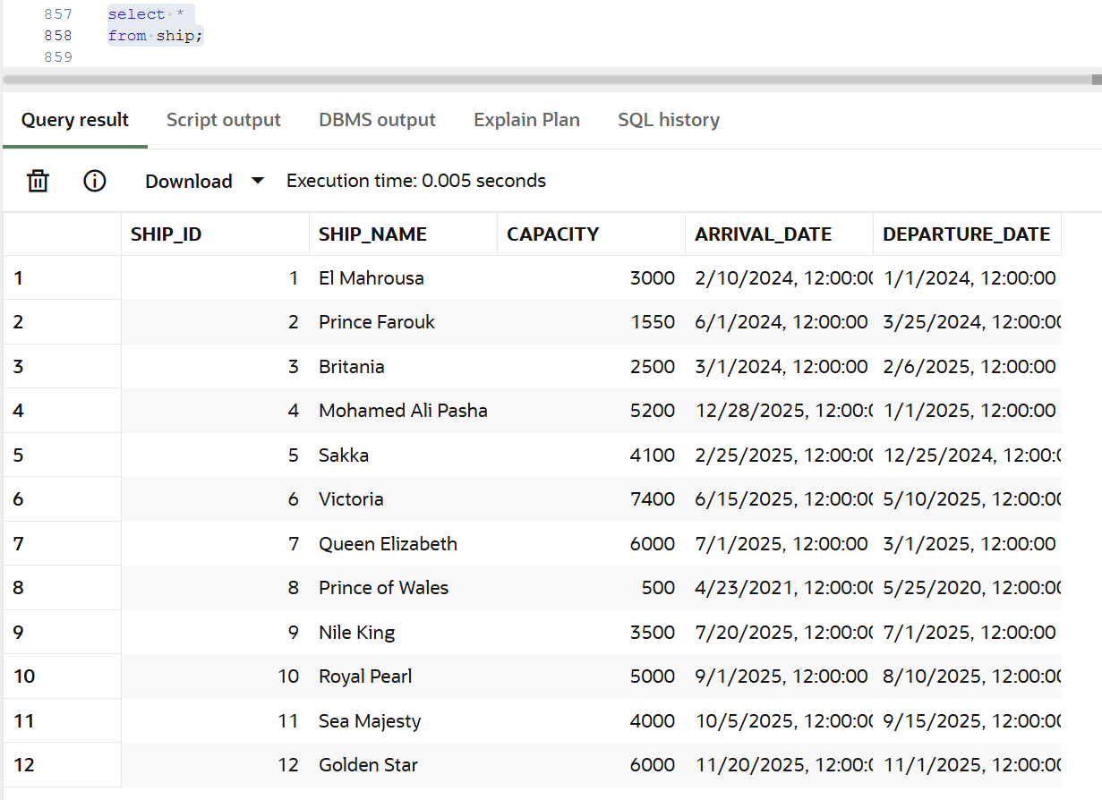
SQL
GBG
Create and select the Ship

Slide 9
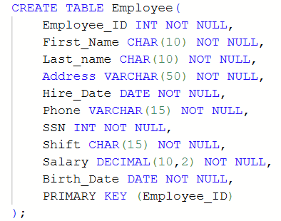
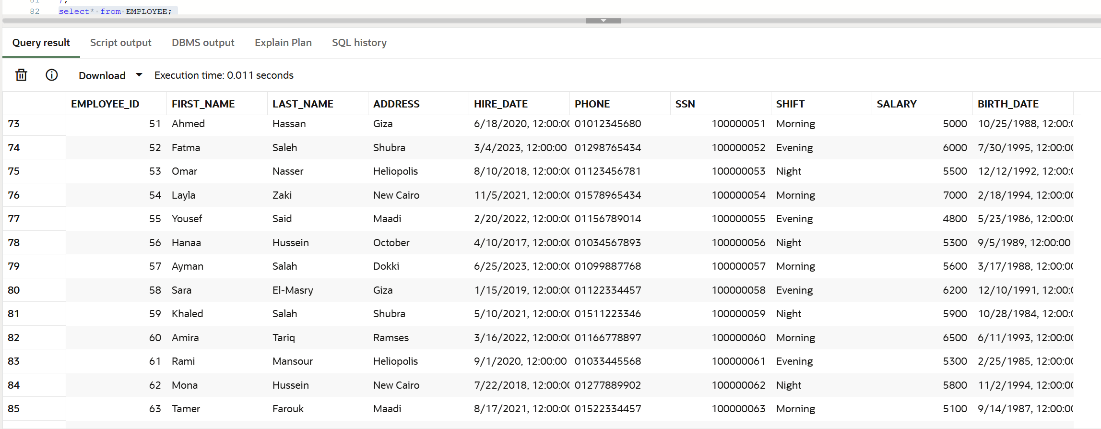
SQL
Create and select the Employee
GBG

Slide 10
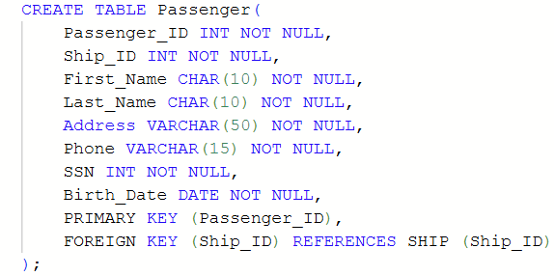
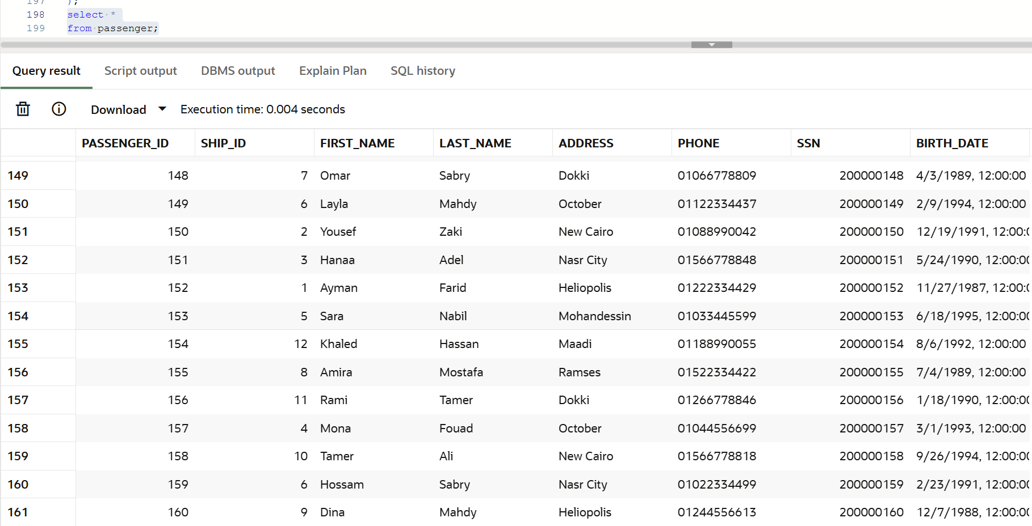
SQL
Create and select the Passenger
GBG

Slide 11
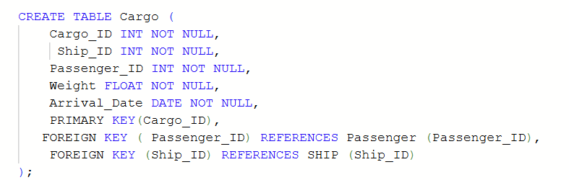
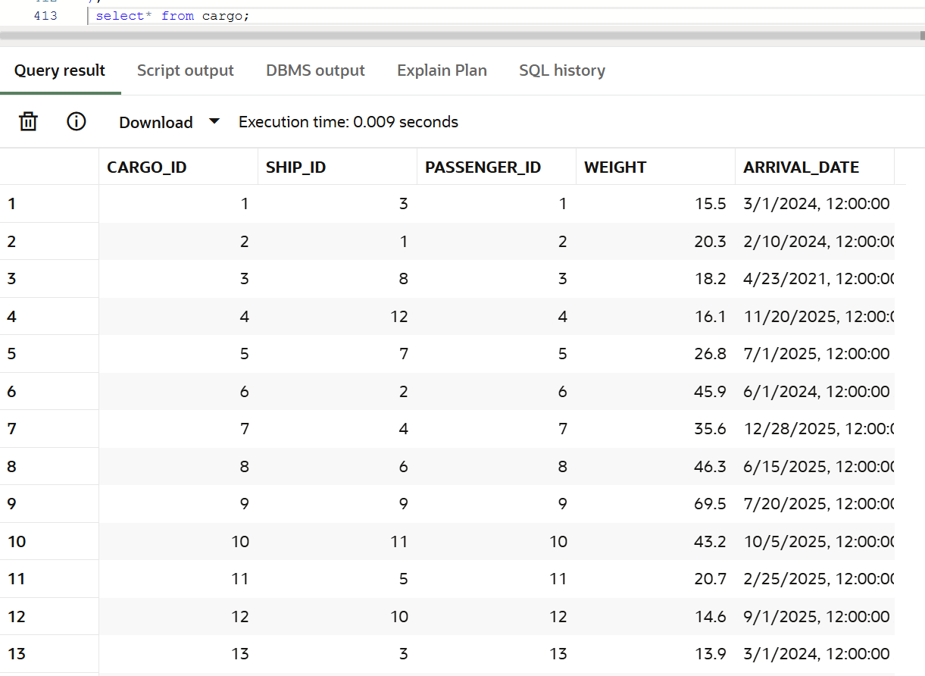
SQL
GBG
Create and select the Cargo

Slide 12
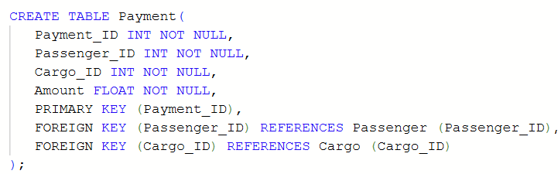
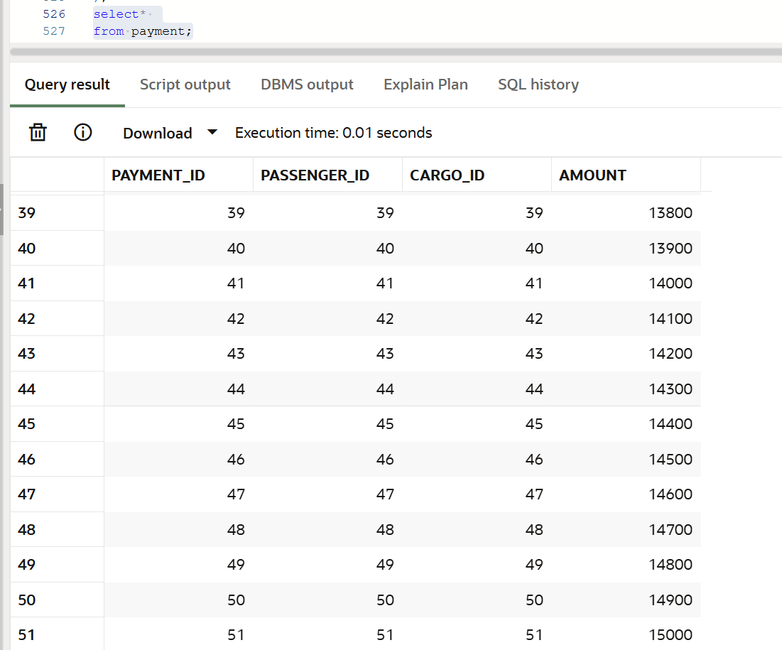
SQL
GBG
Create and Insert Payment

Slide 13
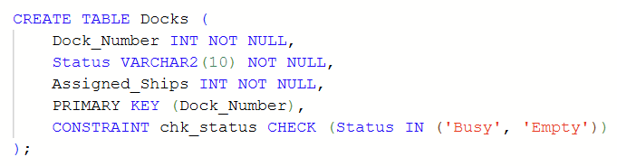
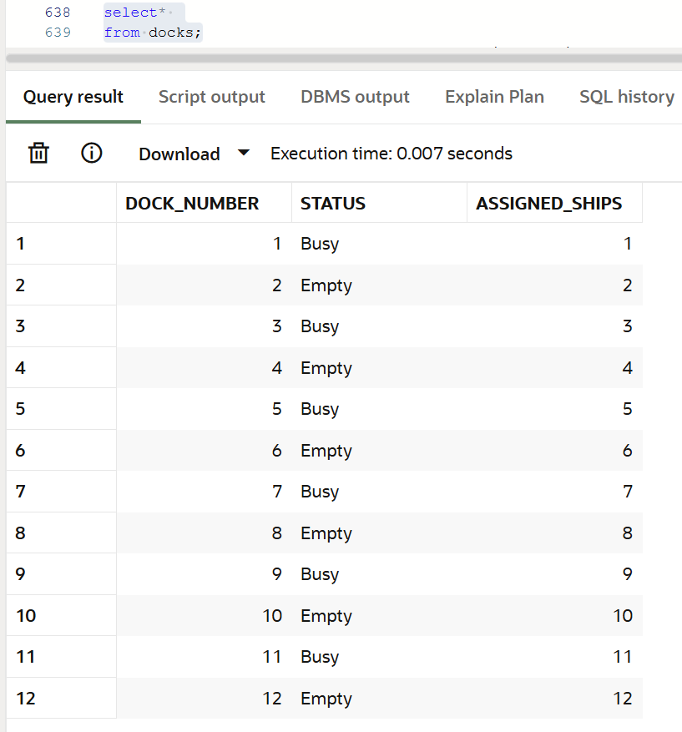
SQL
GBG
Create and select the Docks

Slide 14
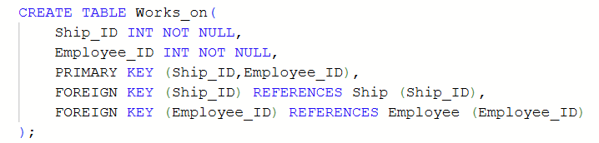
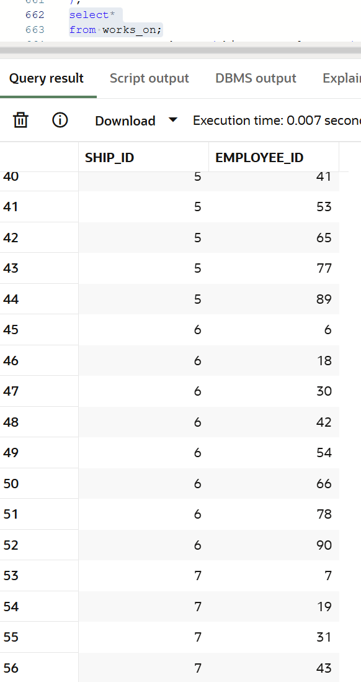
SQL
GBG
Create and create the works-on

Slide 15
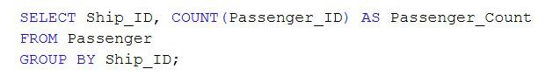
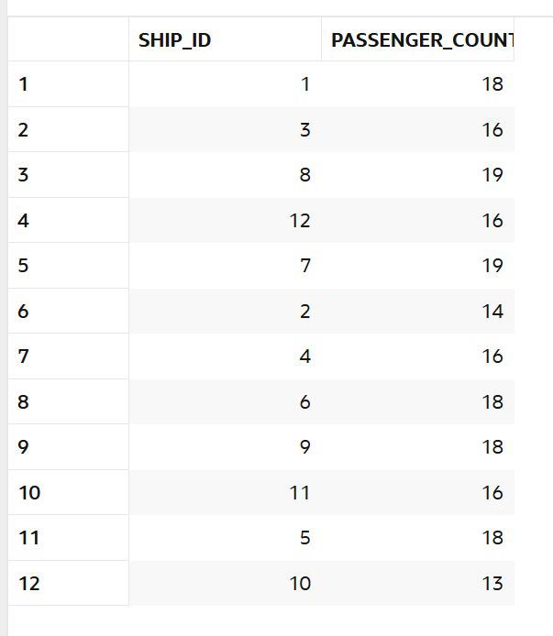
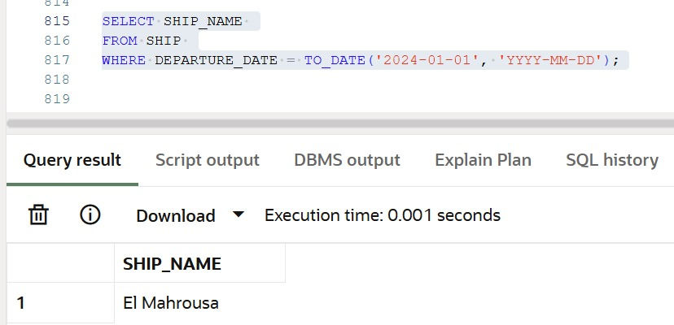
Basic Queries
and Relational Algebra

Slide 16

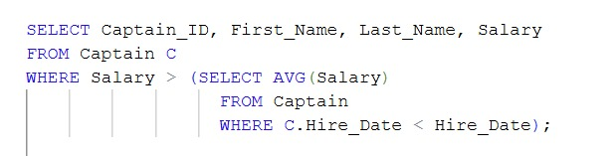
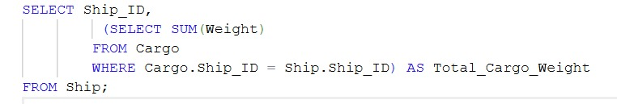

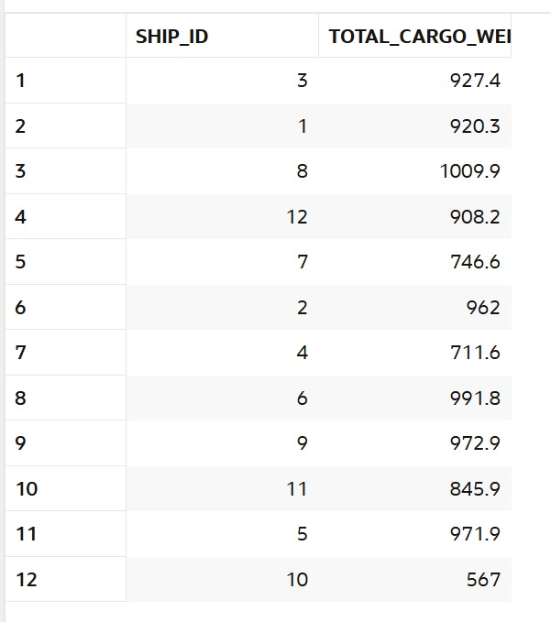
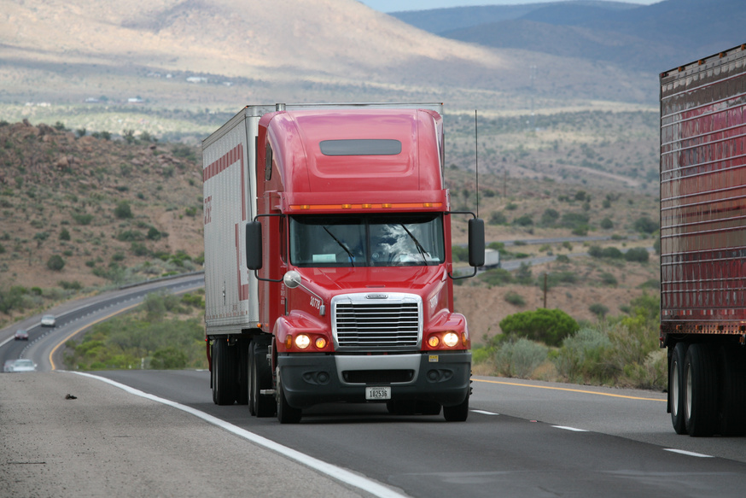
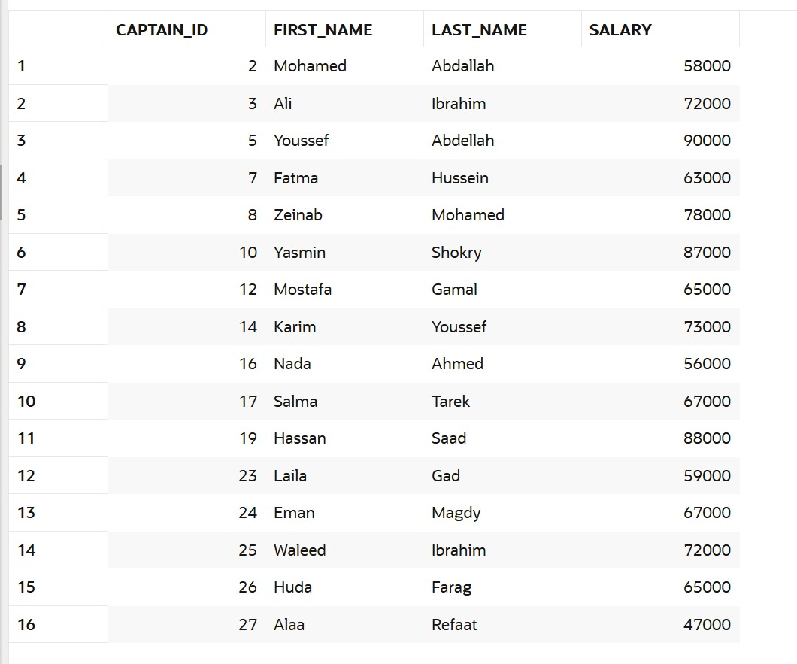
Complex
Queries and Relational Algebra

Slide 17

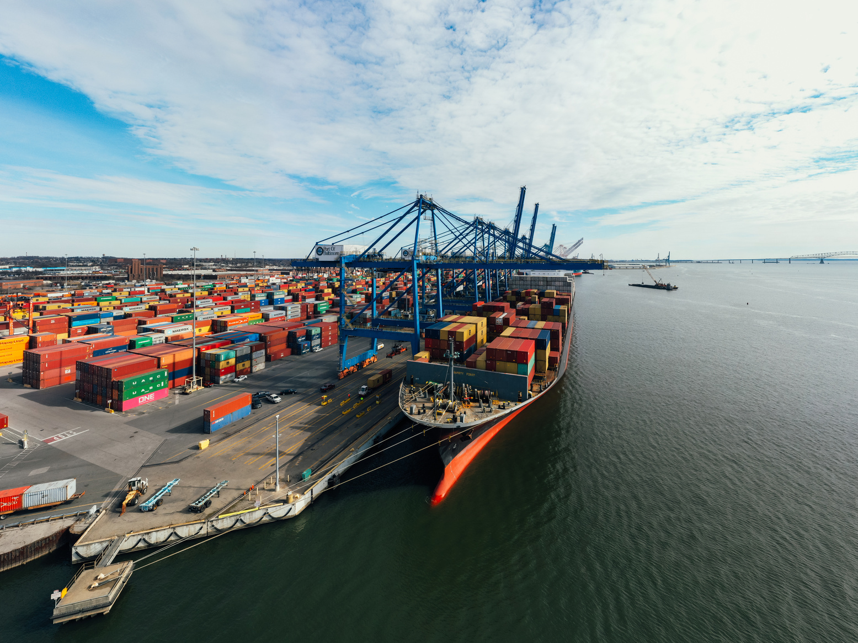
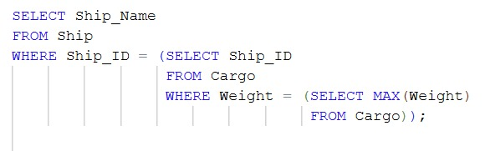
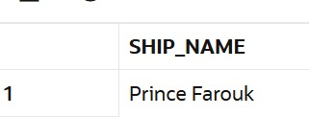
Complex
Queries and Relational Algebra

Slide 18
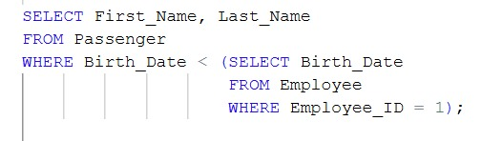
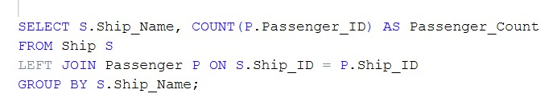
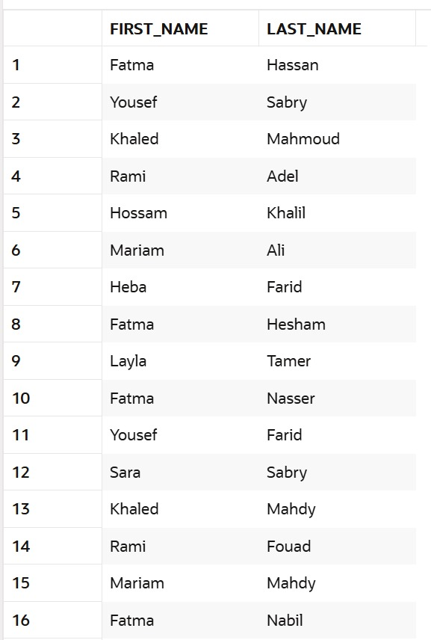
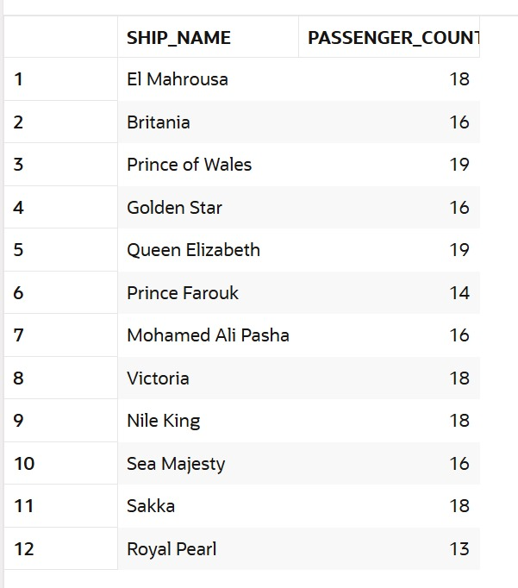


Complex
Queries and Relational Algebra

Slide 19
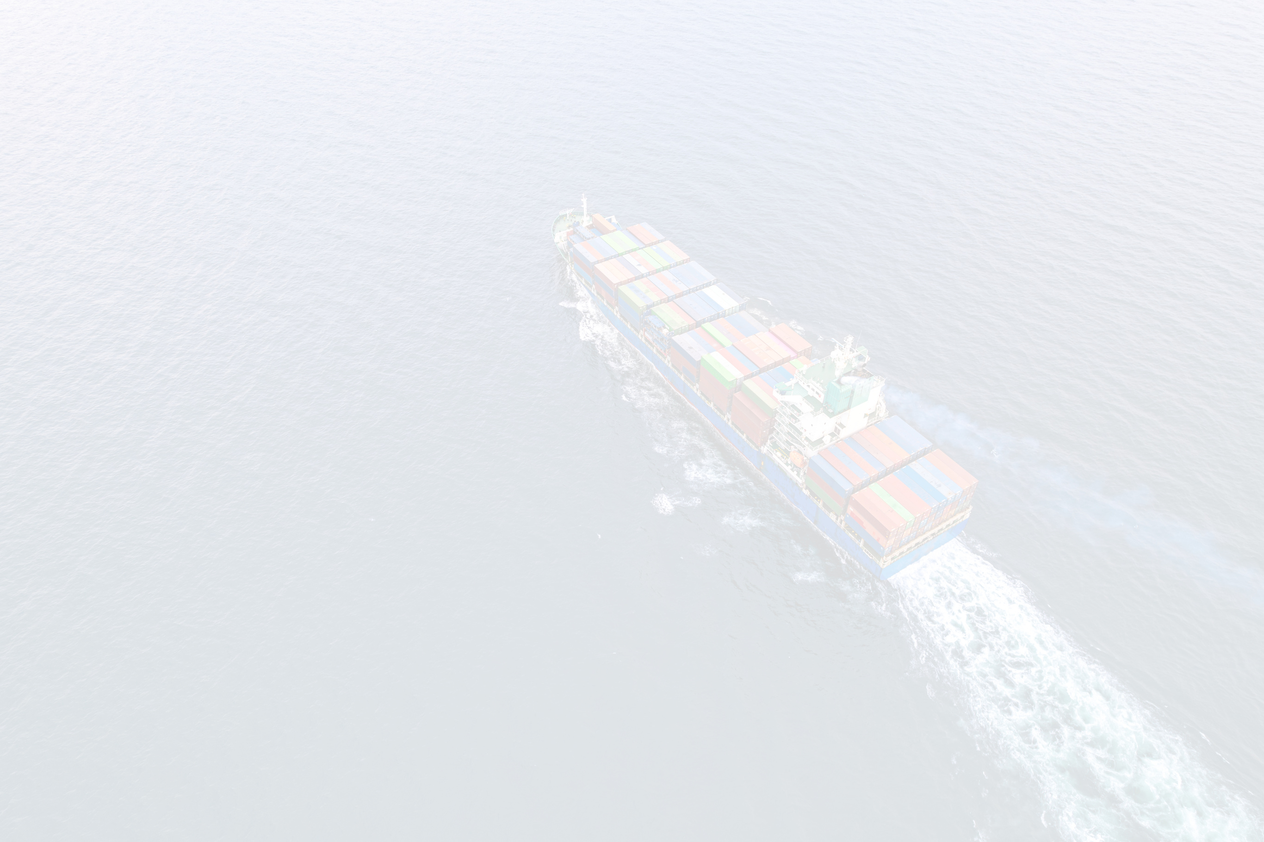
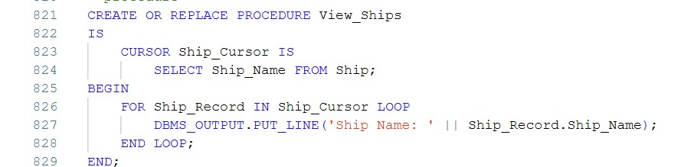

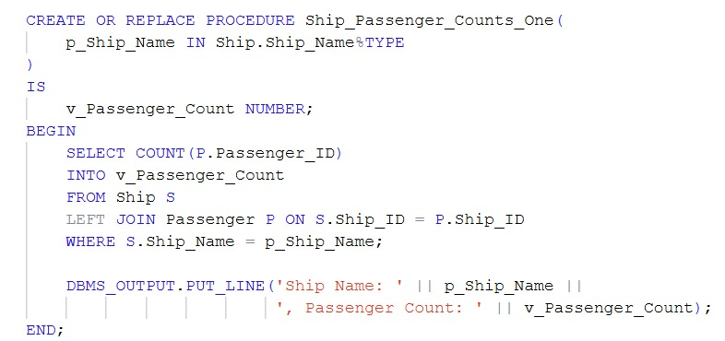
Functions
and Procedure

Slide 20

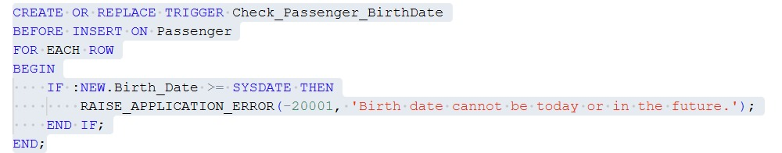

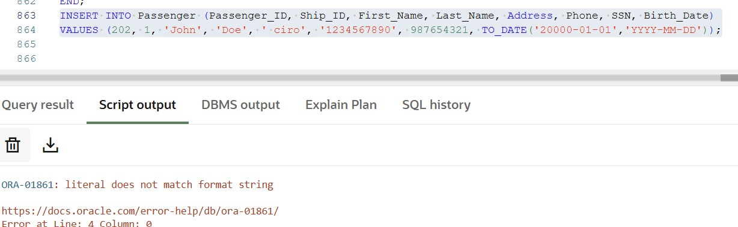
Functions
and Triggers

Slide 21

Thank
You!

